Slide 1
Blood Cell Separation with Magnetophoresis
John Dunec, Ph.D.
VP of Sales, NW USA
© 2012 COMSOL. COMSOL and COMSOL Multiphysics are registered trademarks of COMSOL AB. Capture the Concept, COMSOL Desktop, and LiveLink are trademarks of COMSOL AB. Other product or brand names are trademarks or registered trademarks of their respective holders.

Slide 2
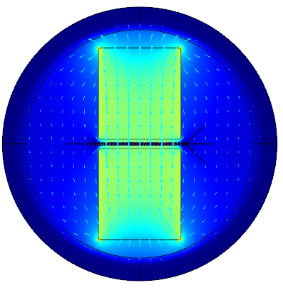
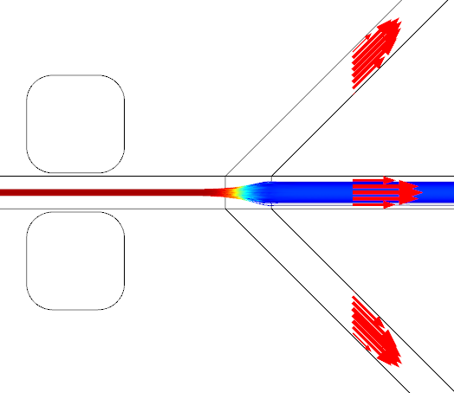
Welcome to the Lunch-Time Tutorials!
Solve One Problem Using COMSOL Multiphysics
This Tutorial: Blood Cell Separation Using Magnetophoresis
30-35 minutes duration
Short Q&A at end
Archived at:
www.comsol.com/webinars
Upcoming Tutorials:
Low Frequency Tumor Ablation
www.comsol.com/events
Presentation, Step-by-Steps, and COMSOL model available on request

Slide 3
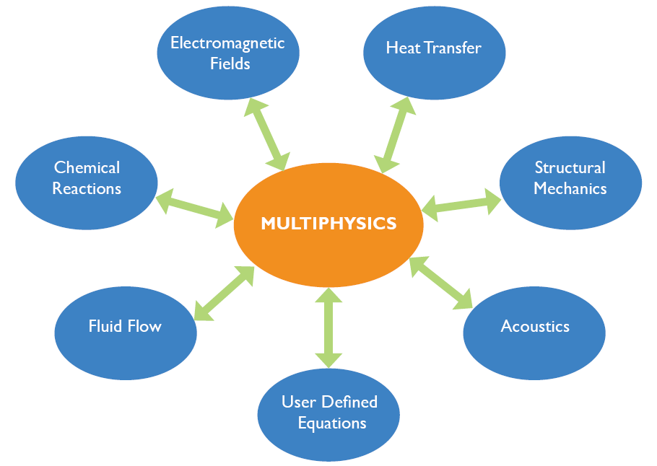
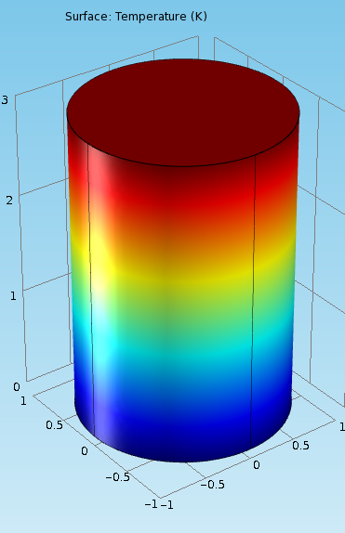
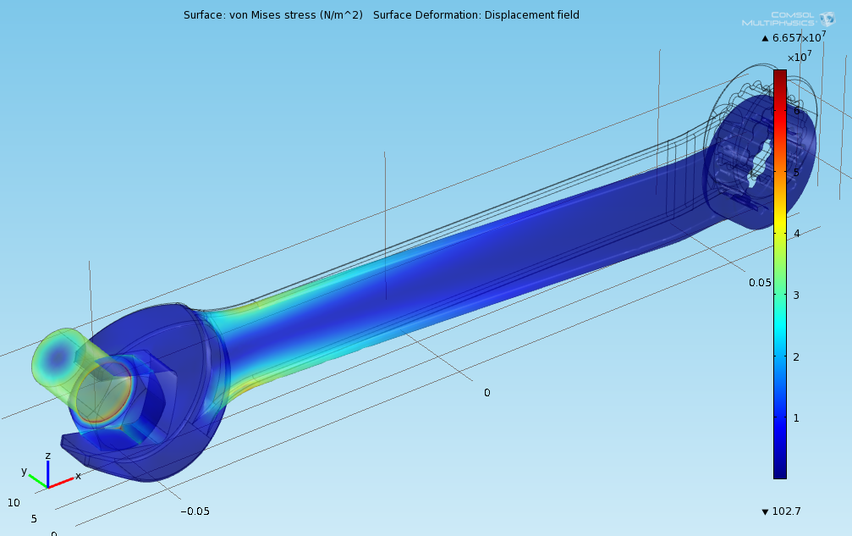
Individual Physics you Learned in School
Heat in a rod, … Stress in a wrench
Individual equation sets … Applied to simple, (and sometimes not-so-simple) single-physics problems

Slide 4
In Reality – Multiple Sets of Physics Interact
Typically bi-directional nonlinear coupling between multiple physical processes
Notes:
The world is typically not that simple!

Slide 5
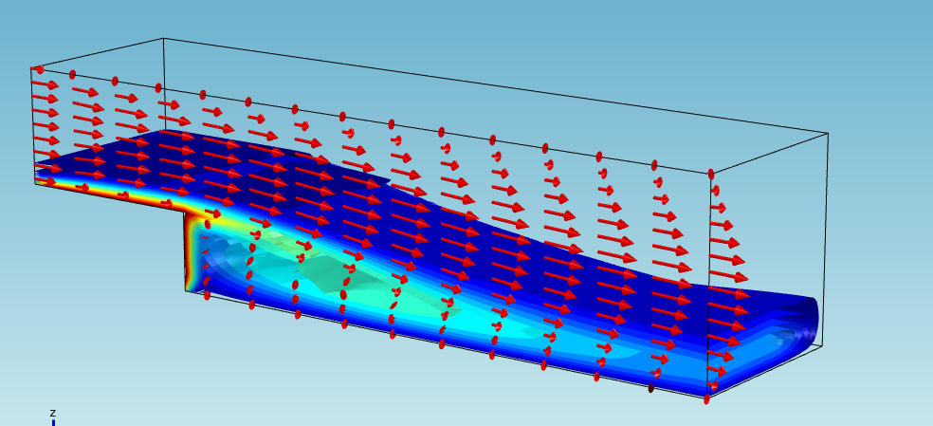
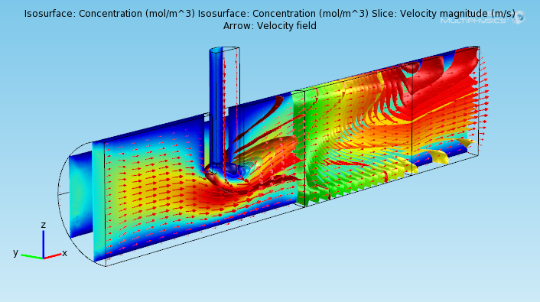
Multiphysics: Multiple Interacting Phenomena
Could be simple:
Heat
Convected by Flow
Could be complex:
Flow
Navier-Stokes in tubes
Porous flow in plug
Mass Transport
Three chemicals: A,B,C
Reacting: A+2B → C
Heat Transfer
Exothermic reaction
Reaction rate temperature dependant
Hot Walls
B
A+2B → C
A,B,C
A
Porous Plug

Slide 6
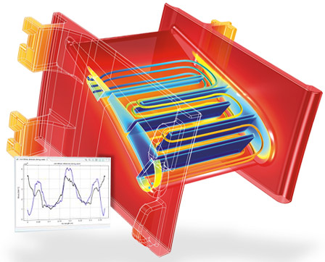
COMSOL Multiphysics Solves These!
Multiphysics – Everything can link to everything.
Flexible – You can model just about anything.
Usable – You can keep your sanity doing it.
Extensible – If its not specifically there…add it!
Trusted by 80,000+ Users Worldwide

Slide 7
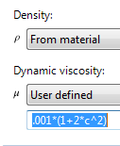
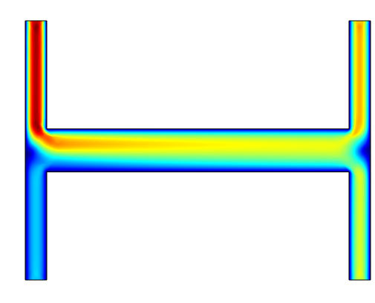
Anywhere you can type a number … you can type an equation
Or an interpolation function …
And it can depend on anything known in your problem
Example: Concentration-dependant viscosity:
Low concentration, High velocity
High concentration, Low velocity

Slide 8
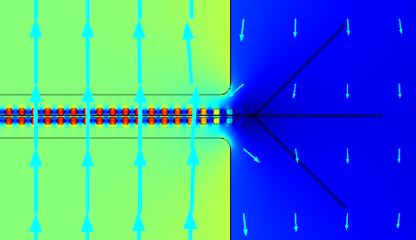
Blood Cell Separation with Magnetophoresis
Key Elements
Simulating a magnetic field from a permanent magnet
Disturbing the e-field to produce magnetic gradients
Simulating flow in a microfluidics lab-on-a-chip set of flow channels
Using Particle Tracing to concentrate blood cells responding to magnetophoretic forces

Slide 9
Reference & Key Separation Property
Model Based on Paper Presented at 2009 COMSOL Conference:
G. Schiavone, D. Kavanagh, & M. Desmulliez, “Design and Simulation of a Microscale Magnetophoretic Device for the Separation of Nucleated Fetal Red Blood Cells from Maternal Blood”, Proceedings of the COMSOL Conference 2009 Milan
Key Material Property:
“The magnetic susceptibility χ_{c} of red blood cells depends on the oxidation state of the haemoglobin molecules. RBCs in a normal state exhibit an extremely weak diamagnetic behaviour as χ_{c} is negative and quite close to zero.”
Χ_{c} = -3.9e-6 Therefore permeability = (1 – 3.9e-6)

Slide 10
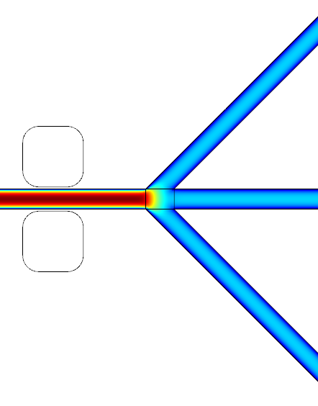
3 Physics: Magnetics, Flow, & Particle Tracing
Magnetics Fluid Flow Particle Tracing
Particles respond to both Drag and Magnetophoretic Forces

Slide 11
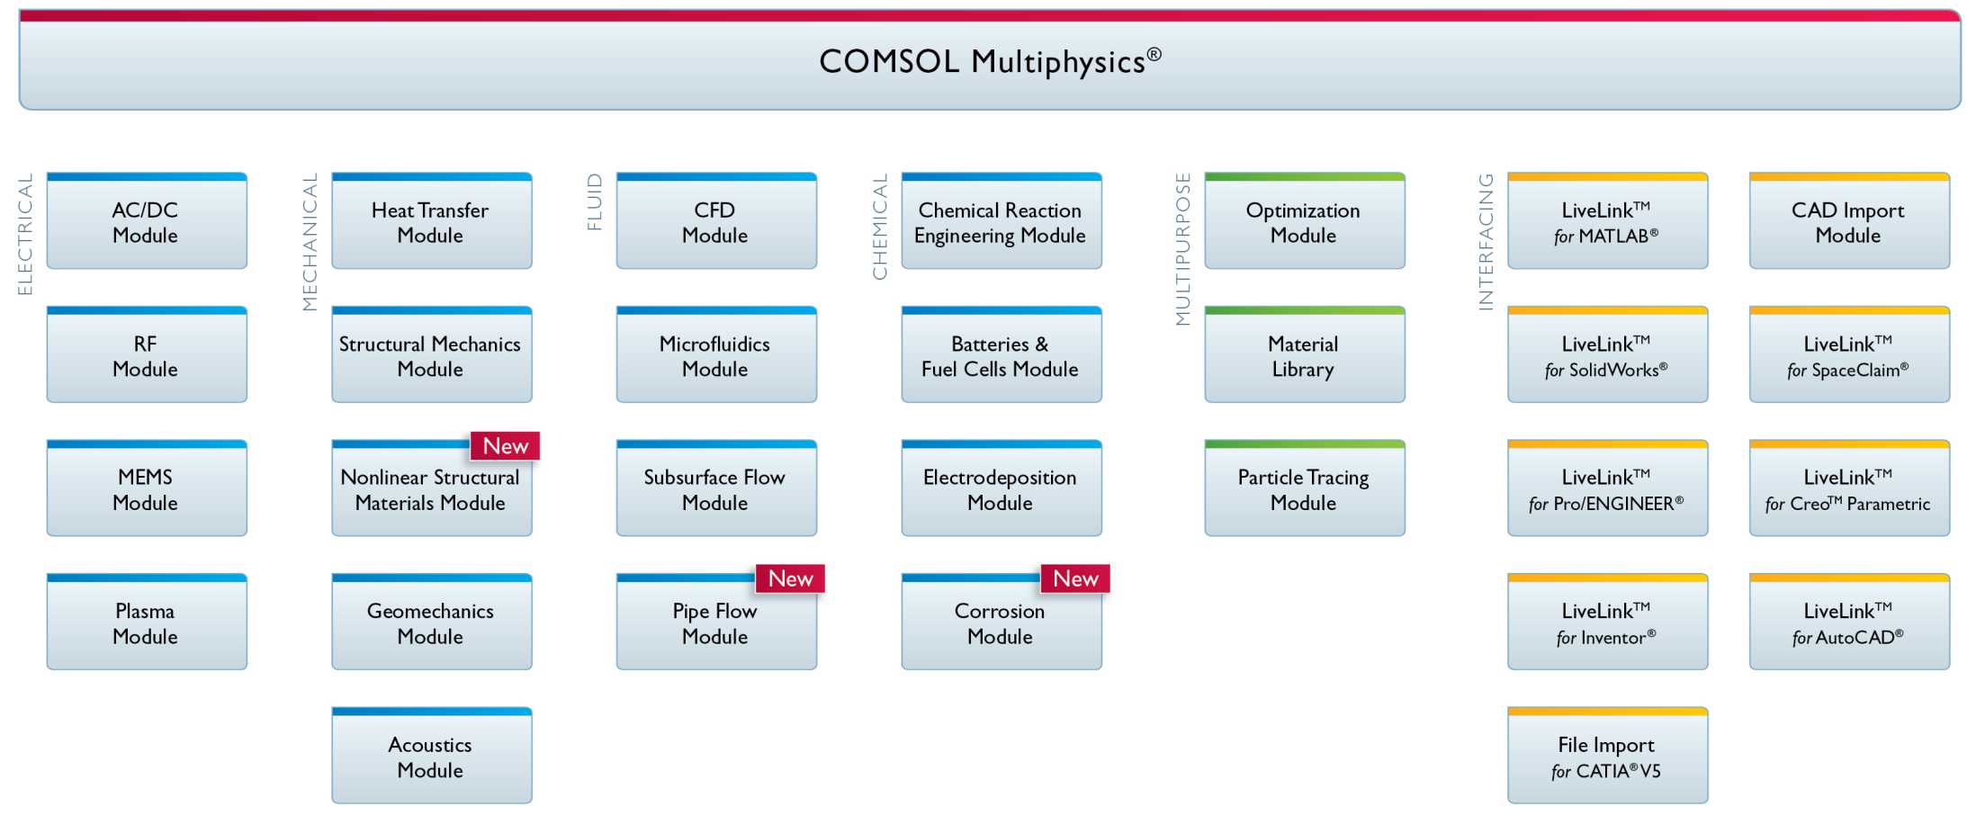
COMSOL Products Used – This Tutorial
COMSOL Multiphysics, AC/DC Module, Microfluidics Module
Along with the Particle Tracing Module
AutoCAD® and Inventor® are registered trademarks of Autodesk, Inc. LiveLink™ for AutoCAD® and LiveLink™ for Inventor® are not affiliated with, endorsed by, sponsored by, or supported by Autodesk, Inc. and/or any of its affiliates and/or subsidiaries. CATIA® is a registered trademark of Dassault Systèmes S.A. or its affiliates or subsidiaries. SolidWorks® is a registered trademark of Dassault Systèmes SolidWorks Corporation or its parent, affiliates, or subsidiaries. Creo™ is a trademark and Pro/ENGINEER® is a registered trademark of Parametric Technology Corporation or its subsidiaries in the U.S and/or in other countries. MATLAB® is a registered trademark of The MathWorks, Inc.

Slide 12
Tutorial Roadmap
First: Setup and Solve Magnetics & Flow
Choose two physics
Import geometry sequence
Define materials (Glass, Soft Iron, Water)
Set up Permanent Magnet
Set Flow Boundary Conditions
Mesh
Solve
Finally: Add Particle Tracing
Magnetic Field Surrounding Neodymium Magnets

Slide 13
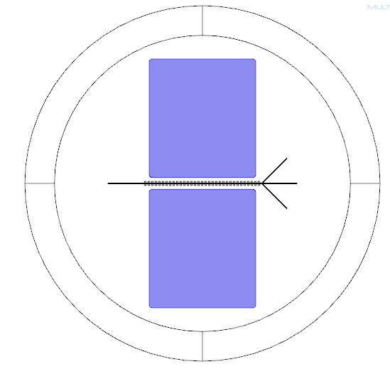
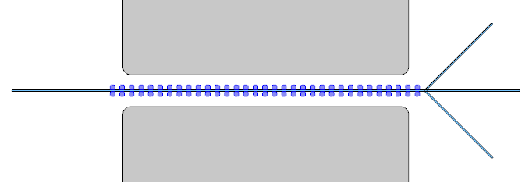
Geometry
Magnet
Glass Substrate
Two Neodymium Permanent Magnets
Microfluidics Flow Channel with 3 Outlets
Passive Array of Soft Iron Patches (Creates Field Gradients)
Flow Channel
Magnet
Array of Soft Iron Patches

Slide 14
Magnetic Equations
Solve Magnetics based on Magnetic Potential
Ampere’s Law relates H and B
In Permanent Magnets H related to B through Magnetism M

Slide 15
Let’s do this in COMSOL …

Slide 16
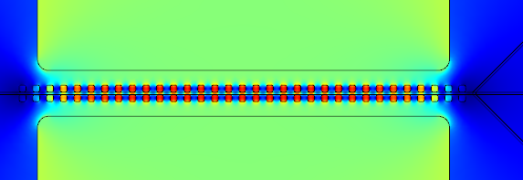
Solution Should be Done
164,000 Degrees of Freedom
37 seconds on my desktop

Slide 17
Next Add Particle Tracing for Blood Cells
Add 2nd Physics:
Particle Tracing, Transient
Define Particle Physics
Define the Particle Properties
Add the Drag Force, Link to velocity field
Add the Magnetophoretic Force, Link to B field
Create an Inlet (100 cells, velocity = V_inlet)
Set up Transient Study
Time Stepping
Link Transient Particle Tracing to Previous Study

Slide 18
Forces on the Blood Cells
Newton’s Law – recast to change in momentum
The magnetophoretic force is based on the gradient magnetic field
The fluid dynamic drag will be that predicted by Stokes law:

Slide 19
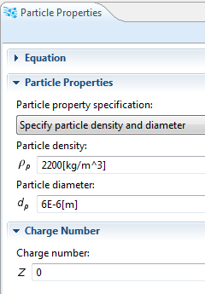
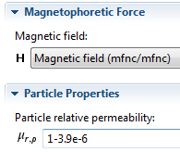
Particle Properties
Density: 2200[kg/m^3]
Diameter: 6e-6[m]
Charge Number: 0
Permeability: (1 – 3.9e-6)
Red Blood Cells are somewhat “donut” shaped with a major diameter of about 9 microns and a thickness of about 3 microns. An equivalent sphere is roughly 6 microns in diameter.

Slide 20
Let’s do this in COMSOL …

Slide 21
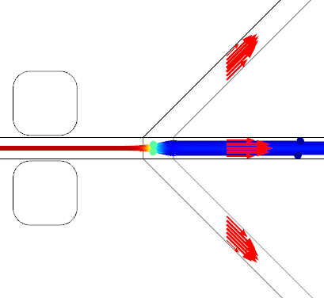
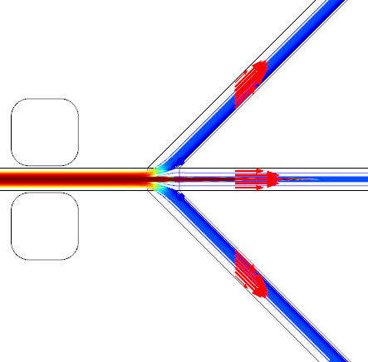
Solution Should be Done
200 Degrees of Freedom
27 seconds on my desktop
WITH Magnetophoretic Force
WITHOUT Magnetophoretic Force

Slide 22
Tutorial Review
First: Setup and Solve Magnetics and Flow
Import geometry sequence
Define materials (Glass, Soft Iron, Water)
Set up Permanent Magnet
Set Flow Boundary Conditions
Mesh & Solve
Next: Add Particle Tracing
Add Particle Tracing
Setup Particle Properties
Add Forces, Link to B-field & Flow
Set up 100 cells at inlet
Set up time-steps, link to previous study
Solve again

Slide 23

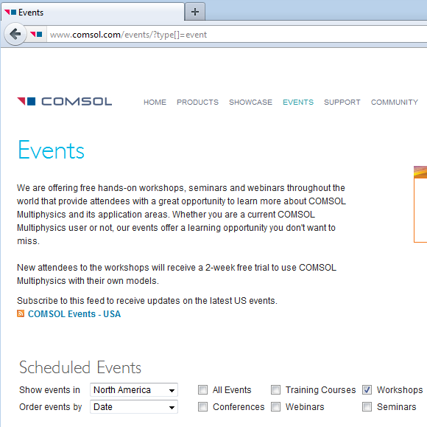
To Get More Information …
Attend a Free Seminar
Includes 2-week trial of COMSOL
www.comsol.com/events
Attend our Webinars
www.comsol.com/events/webinars/
Contact Your Local COMSOL Office
www.comsol.com/contact
Attend our Annual Conference
www.comsol.com/conference2012

Slide 24
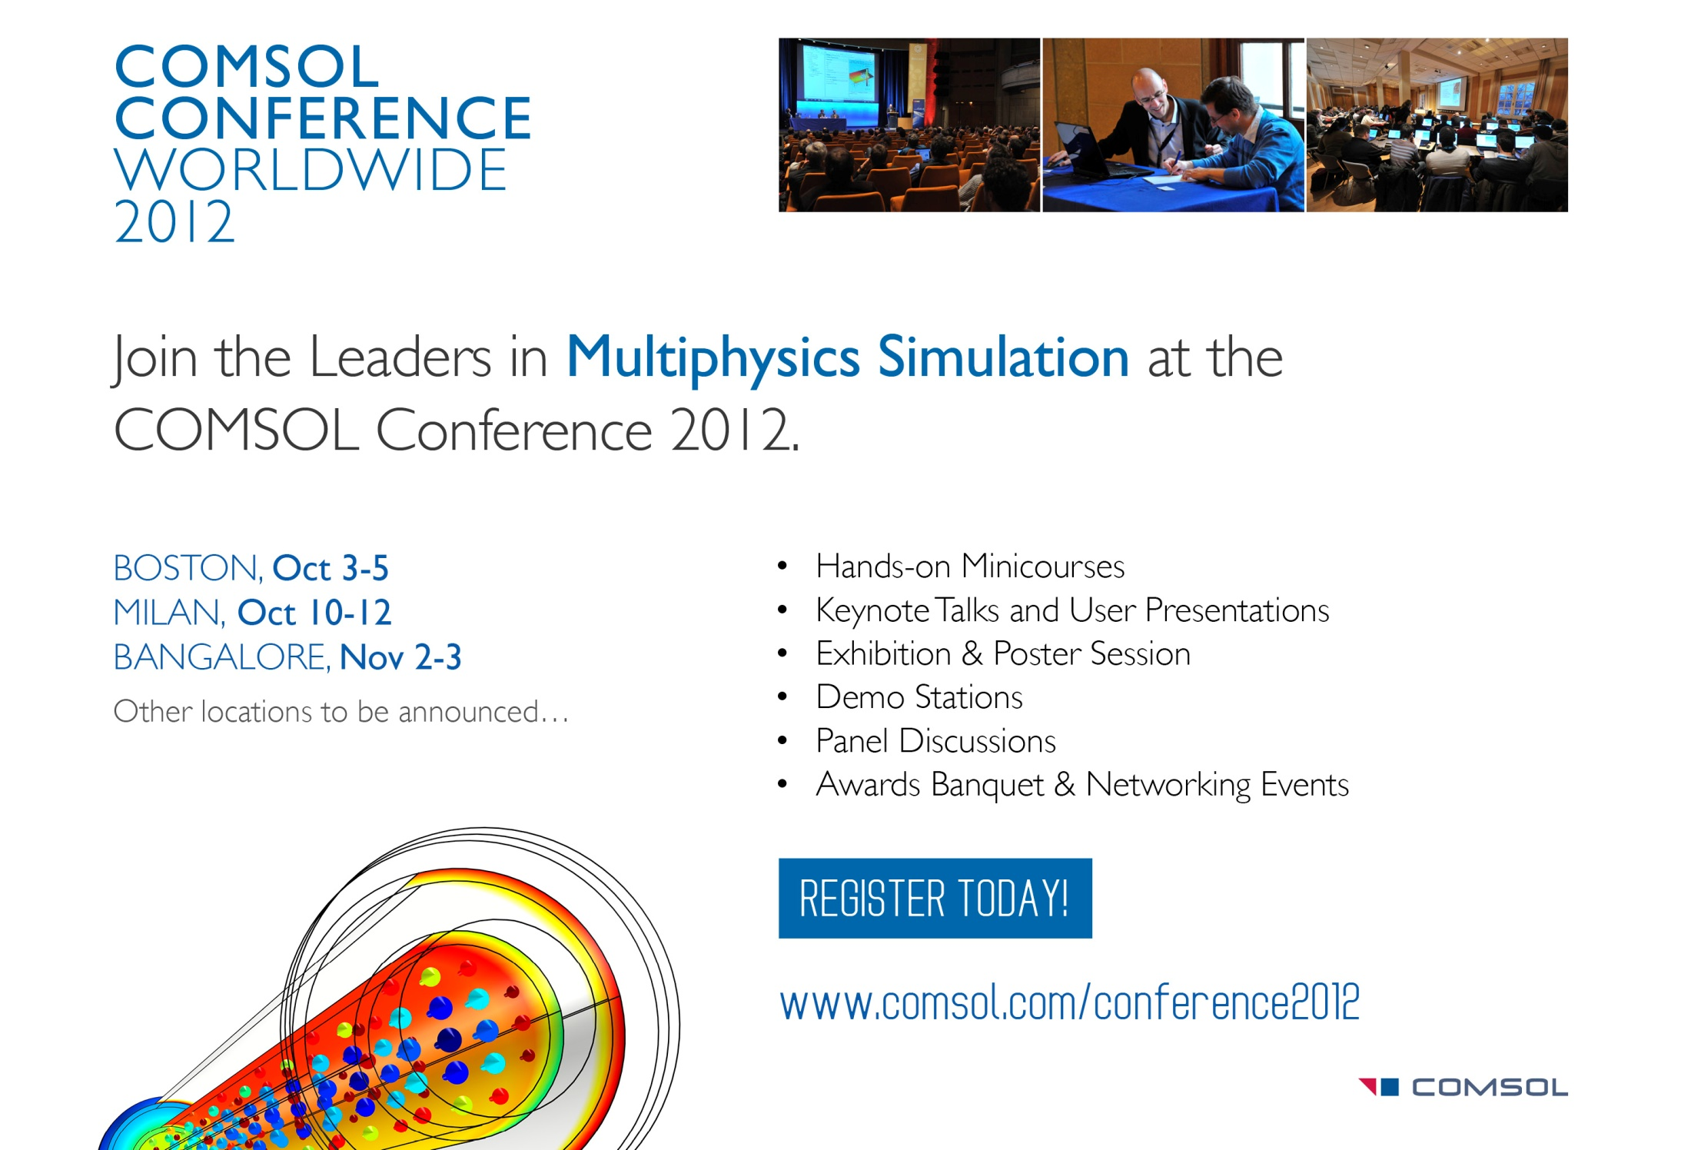

Slide 25


Slide 26
www.comsol.com

Slide 27
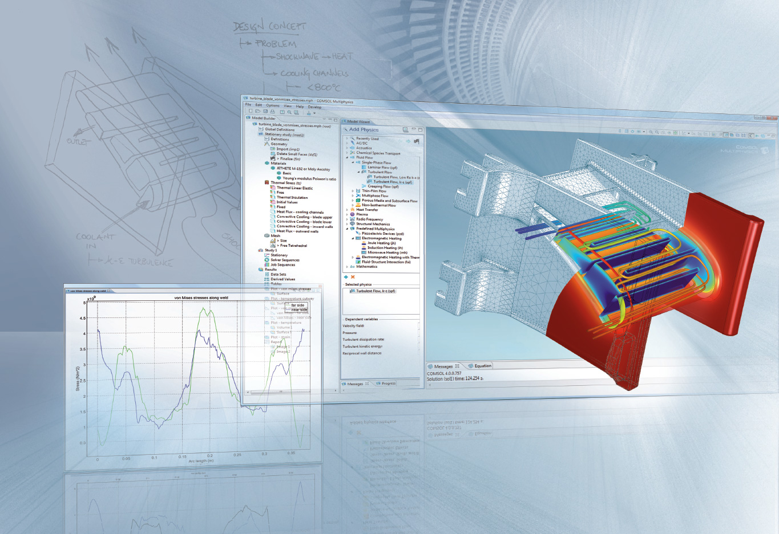
Capture the ConceptTM
Step-by-step Tutorial

Slide 28
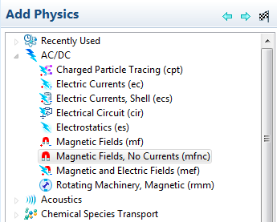
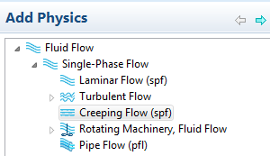
First Solve for Magnetic Field and Flow
Choose File > New , 2D
Rt Click on “AC/DC” > “Magnetic Fields, No Currents”
Add to Model
Rt Click on “Fluid Flow” > “Single- Phase Flow > “Creeping Flow”
Add to Model
Choose “Stationary”

Slide 29
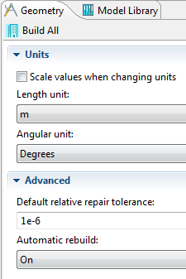
Units – Meters
Highlight “Geometry1”
Leave units as “m”

Slide 30
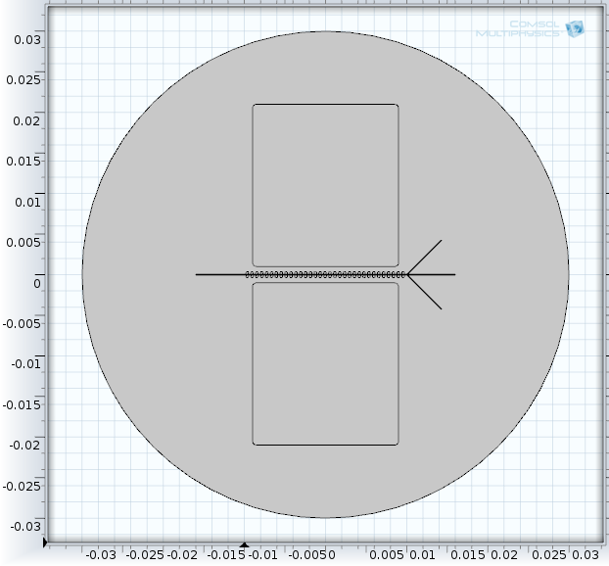
Import Geometry Sequence
Right click on Geometry
Choose “Import Sequence from File”
Navigate to File Location
Choose: “Magnetophoresis_GEOM_SEQUENCE
Choose “Build All”
NOTE: Step-by-step instructions to build geometry from scratch is at end of presentation

Slide 31
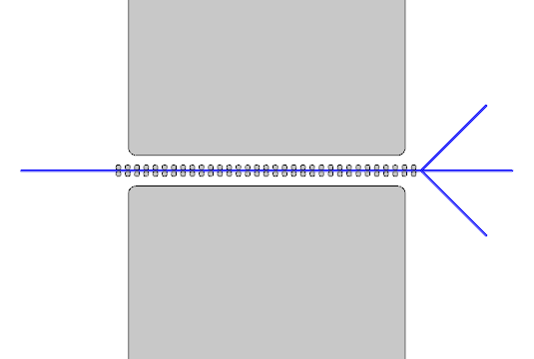
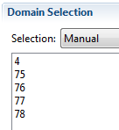
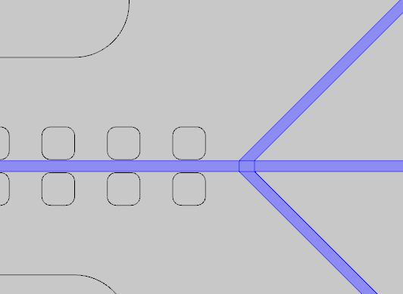
Limit Where Flow is Calculated
Do this before adding materials to avoid unnecessary stop signs!
Highlight “Creeping Flow”
Clear ALL selections with broom
Select the flow channels (be sure to include the small rectangle)

Slide 32
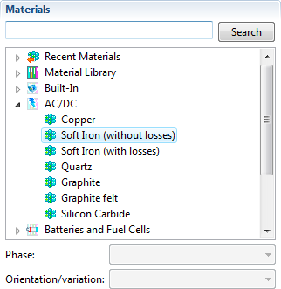
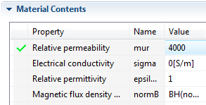
Materials – Soft Iron
Rt Click on “Materials”
Choose “Material Browser”
Expand “AC/DC”
Rt click on “Soft Iron (without losses)”
Add material to Model
Set “mur” to “4000”

Slide 33
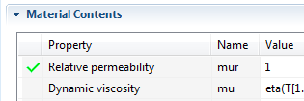
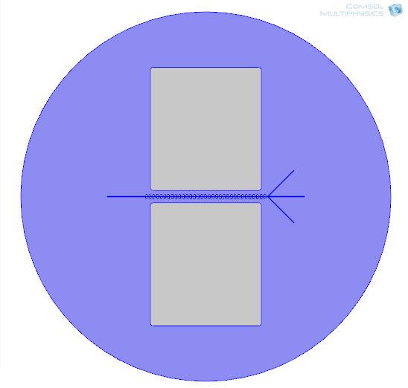
Materials – Water and Glass
Pick “Material Browser” tab
Expand “Built-in”
Rt click on “Water, liquid”
Add material to Model
Select the flow channels (be sure to include the small rectangle)
Set “mur” to “1”
Pick “Material Browser” tab
Rt click on “Glass (quartz)”
Add material to Model
Select the outer circular domain

Slide 34
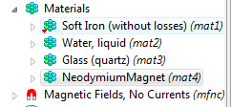
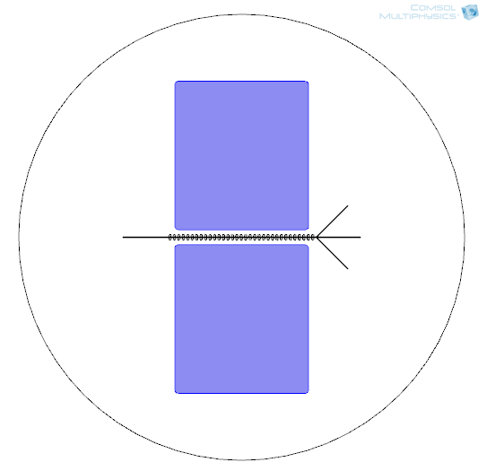
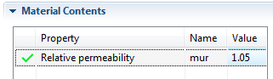
Create a Material: NeodymiumMagnet
Rt Click on “Materials”
Choose “Material”
Name Material
Rt Click on “Material 4”
Rename to “NeodymiumMagnet”
Set Material Properties
Select the two magnet domains
Set “mur” as 1.05

Slide 35
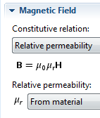
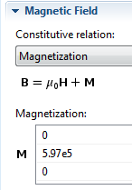
Magnetize the Permanent Magnet
Rt Click on “Magnetic Fields, No Currents”
Choose “Magnetic Flux Conservation” (This adds a 2nd Mag Flux Conserv. Node)
Select both Neodymium Magnet domains
Locate the “Magnetic Field” section
change “Relative permeability” to “Magnetization”
Enter y component of M as “5.97e5”

Slide 36
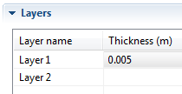
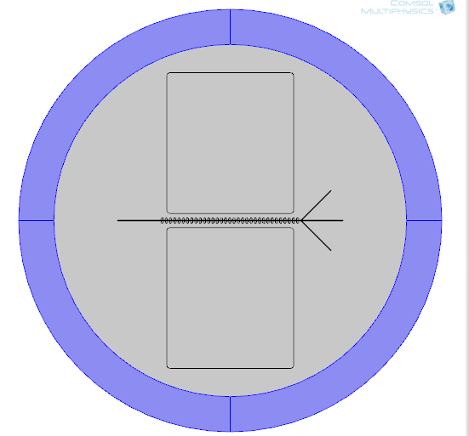
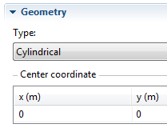
Avoid Field Distortion by Outer Boundary
Add Infinite Element Geometry
Expand “Geometry 1”
Highlight “Circle 1 Overall …”
Expand “Layers” Section
Enter Layer Thickness as “0.005”
Build all
Add Infinite Element Domains
Rt Click on “Definitions”
Choose “Infinite Element Domains”
Select the new outer layers
Change the “Type” to “Cylindrical”

Slide 37
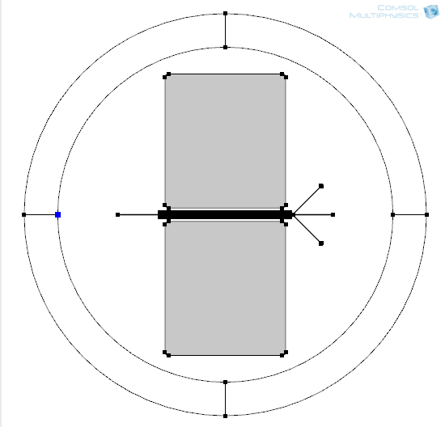
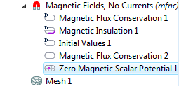
Magnetic Potential Needs One Known Point
Set the magnetic value somewhere:
Rt Click on “Magnetic Fields, No Currents”
Choose “Points” > “Zero Magnetic Scalar Potential”
Select the Leftmost Point to right of infinite element domains

Slide 38
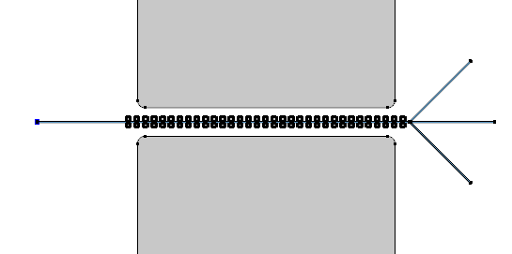
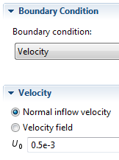
Flow Boundary Conditions: Inlet
Rt Click on “Creeping Flow”
Choose “Inlet”
Select the leftmost vertical flow boundary
Change “Boundary Condition” to “Velocity”
Enter Velocity as “0.5e-3”

Slide 39
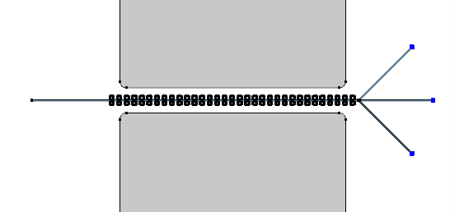
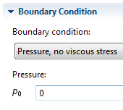
Flow Boundary Conditions: Outlet
Rt Click on “Creeping Flow”
Choose “Outlet”
Select the three right-most vertical flow boundaries
Leave “Boundary Condition” as “Pressure, …”
Leave Pressure as “0”

Slide 40
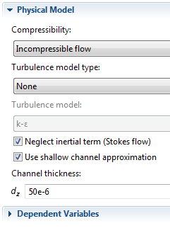
Set Channel Depth
Highlight “Creeping Flow”
Change Compressibility to “Incompressible flow”
Select “Use shallow channel approximation”
Enter d_{z} as “50e-6”

Slide 41
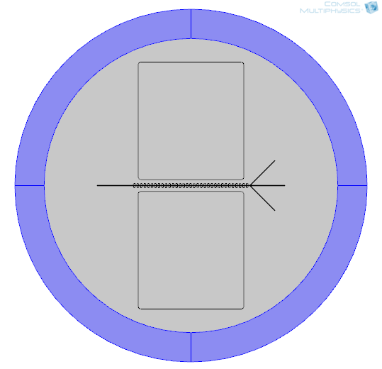




Mesh the Infinite Element Domain
Rt Click on “Mesh 1”
Choose “Mapped”
Select the 4 Infinite Element domains
Rt Click on “Mapped 1”
Choose “Distribution”
Select the top vertical boundary
Number of Elements: 3
Rt Click on “Mapped 1”
Choose “Distribution”
Select the outer circle boundaries
Number of Elements: 15

Slide 42





Mesh the Inlet Flow Channel
Rt Click on “Mesh 1”
Choose “Mapped”
Select the inlet flow domain
Rt Click on “Mapped 2”
Choose “Distribution”
Select right vertical boundary
Number of Elements: 10
Rt Click on “Mapped 2”
Choose “Distribution”
Select top inlet channel boundary
Number of Elements: 1500

Slide 43



Mesh the Small Flow Rectangle
Rt Click on “Mesh 1”
Choose “Mapped”
Select the small flow domain
Rt Click on “Mapped 3”
Choose “Distribution”
Select top rectangle boundary
Number of Elements: 10
Build All

Slide 44


Mesh the Outlet Channels
Rt Click on “Mesh 1”
Choose “Mapped”
Select the 3 outlet flow domains
Build All

Slide 45


Distribution – Upper Outlet
Rt Click on “Mapped 4”
Choose “Distribution”
Select BOTH the long upper outlet boundaries
Change to “Predefined distribution”
Number of Elements: 70
Element Ratio: 10
Distribution method: Arithmetic seq
Build All

Slide 46


Distribution – Lower Outlet
Rt Click on “Mapped 4”
Choose “Distribution”
Select BOTH the long lower outlet boundaries
Change to “Predefined distribution”
Number of Elements: 70
Element Ratio: 10
Distribution method: Arithmetic seq
Choose “Reverse direction”
Build All

Slide 47

Distribution – Middle Outlet
Rt Click on “Mapped 4”
Choose “Distribution”
Select BOTH the long middle outlet boundaries
Change to “Predefined distribution”
Number of Elements: 70
Element Ratio: 10
Distribution method: Arithmetic seq
Choose “Reverse direction”
Build All

Slide 48



Set up Two-Step Study
Rt Click on “Study 1”
Choose “Study Steps”
Choose “Stationary”
Highlight “Step 1: Stationary”
Deselect Calculating Flow
Highlight “Step 2: Stationary 2”
Deselect Calculating Magnetics
Rt Click on “Study 1”
Rename to “Study 1 Flow and Magnetic Field”

Slide 49



Solve for Flow and Magnetic Field
Rt Click on “Study 1 …”
Hit Compute
Magnetic Field
Flow Velocity
Magnetic Field

Slide 50

Add Arrows for Magnetic Flux
Expand “Results”
Rt Click on “Magnetic Flux Density”
Choose “Arrow Surface”
Plot “Magnetic Flux Density”
X-points: 25
Y-points: 20
Scale Factor: 0.006
Color: Cyan

Slide 51


Add Particle Tracing
Rt click on “Model 1”
Choose “Add Physics”
Choose “Fluid Flow” > “Particle Tracing for Fluid Flow”
Choose the blue “Next” arrow
Choose “Time Dependant”
Deselect “Solve For” the other physics
Pick Finish Flag
Note: You need an additional study since particle tracing is transient whereas the magnetic analysis was stationary.

Slide 52


Create Flow Channel Selection
Expand “Materials”
Highlight “Water, Liquid”
Choose the “Create Selection” button
Name the Selection: “Flow Channels”

Slide 53


Particles only in Fluid Domains
Highlight “Particle Tracing for Fluid Flow”
Go to “Domain” section
Pick “Clear Selection” button (the broom)
Choose “Flow Channels” domains in the selection list

Slide 54

Walls – Change to “Bounce”
Under “Particle Tracing for Fluid Flow”
Highlight “Wall 1”
Change “Wall Condition” to “Bounce”
Cells bounce back into main flow

Slide 55
Set Particle Properties
Under “Particle Tracing for Fluid Flow”
Highlight “Particle Properties 1”
Set to “Specify particle density and diameter”
Enter Values:
Particle density: 2200[kg/m^3]
Particle diameter: 6e-6[m]
Charge Number: 0
Red Blood Cells are somewhat “donut” shaped with a major diameter of about 9 microns and a thickness of about 3 microns. This is an equivalent sphere.

Slide 56

Add Fluid Drag Forces
Rt Click on “Particle Tracing for Fluid Flow”
Choose “Drag Force”
In “Domain Selection” section, choose “Flow Channels”
In the “Drag Force” section, change velocity field entry, u, to “Velocity field (spf/fp1)”

Slide 57

Add Magnetophoretic Forces
Rt Click on “Particle Tracing for Fluid Flow”
Choose “Magnetophoretic Force”
In “Domain Selection” section, choose “Flow Channels”
In the “Magnetophoretic Force” section, change Magnetic field, H, to “Magnetic field (spf/fp1)”
Enter values:
Particle relative permeability: 1-3.9e-6 (-3.9e-6 is the susceptibility)
Fluid relative permeability: 1

Slide 58


Boundary Cond: Particle Inlet
Rt Click on “Particle Tracing for Fluid Flow”
Choose “Inlet”
Select the left-most vertical flow boundary
Change “Initial position” to “Uniform”
Set “N” to “100”
Set Velocity field to “Velocity field (spf/fp1)”

Slide 59


Boundary Cond: Particle Outlets
Rt Click on “Particle Tracing for Fluid Flow”
Choose “Outlet”
Select the 3 right-most vertical flow boundaries
Leave “Wall Condition” as “Freeze”

Slide 60



Assign Stationary Solver to Flow & Magnetics
Expand “Study 1”
Note: Both of the following are likely to have been done for you already
Highlight “Step 1: Stationary”
In the “Physics Selection”:
Deselect “Charged Particle Tracing”
Highlight “Step 2: Stationary 2”
In the “Physics Selection”:
Deselect “Charged Particle Tracing”

Slide 61



Assign Transient Solver to Particle Tracing
Expand “Study 2”
Highlight “Step 1: Time Dependant”
In the “Physics Selection”:
Make sure “Magnetic Fields” is deactivated
Make sure “Creeping Flow” is deactivated
Rename Study
Rt Click on Study 2
Choose “Rename”
Change name to “Study 2 Blood Cells”

Slide 62


Use Magnetics & Flow Solution from Study 1
Under “Step 1: Time Dependant”
Expand the “Values of Dependent Variables” section
Select “Values of variables not solve for”
Method: “Solution”
Study: “Study 1, Stationary”
Stationary: “Automatic”

Slide 63

Set Times and Solve
Highlight “Step 1: Time Dependant”
Choose the “Range” button
Leave entry method as “Step”
Start: “0”
Step: “0.1”
Stop: “60”
Pick “Replace”
Rt Click on Study 2 > Hit Compute
(Takes about 27 seconds)

Slide 64


Plot Particles as 3x Actual Size
Expand Particle Trajectories (cpt)
Highlight “Particle Trajectories 1”
Leave “Type” as “Point”
Change Radius expression to 6e-6
Select Radius Scale Factor
Enter Radius Scale Factor as “3”
Plot
Zoom in on Y-Transition

Slide 65


Add Lines to Trajectories
Highlight “Particle Trajectories 1”
Change “Type” to “Line”
Plot

Slide 66

Add Arrow Plot
Expand “Results”
Rt Click on “Particle Trajectories (fpt)”
Choose “Arrow Surface”
Plot Flow Velocity (u, v)
Change x-Method to “Coordinates”
Set x coord to 0.0104
Change y-Method to “Coordinates”
Range: -0.0006 to 0.0006 in 65 steps
Scale Factor: 1

Slide 67
Compare with NO Magnetophoretic Force
Expand “Particle Tracing For Fluid Flow”
Rt Click on “Magnetophoretic Force”
Choose “Disable”
Rt Click on “Study 2”
Hit Compute
WITHOUT Magnetophoretic Force
With Magnetophoretic Force

Slide 68
www.comsol.com

